Slide 1

COMPUTER NETWORKS
(BCSC 0008)
Copyright content, use only with the written permission of presenter mentioned
Lecture 21

Slide 2
Text and Reference Books
Text Books:
Fourouzan B. A. (2004), “Data Communication and Networking”, 4th Edition, McGraw-Hill.
References:
Kurose, J. F. and Ross K. W. (2005), “Computer Networking: A Top-Down Approach Featuring the Internet”, 3rd Edition, Addison-Wesley.
A. S. Tanenbaum (2006), “Computer Networks”, 2nd Edition, Prentice Hall India.

Slide 3
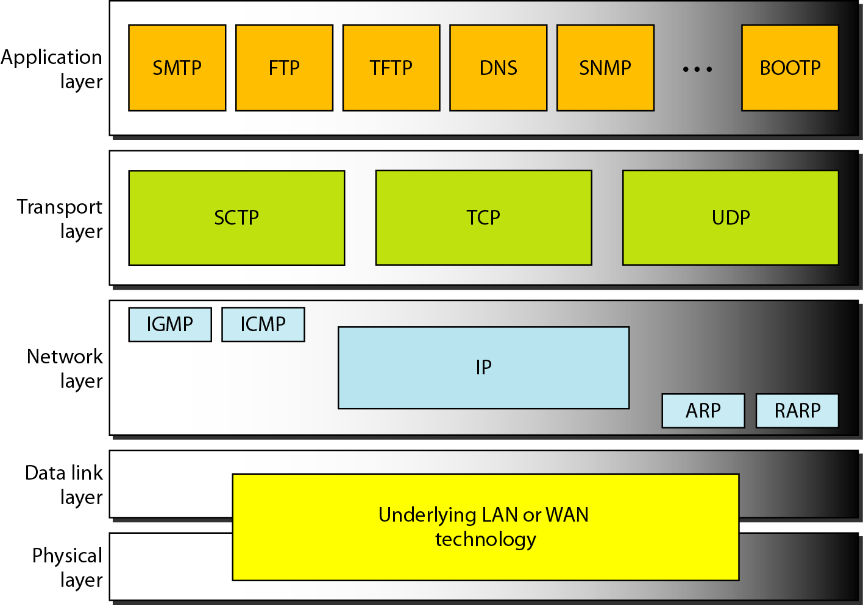
Transport Layer: Introduction

Slide 4
Why we need transport layer?
Network layer is responsible for end to end (Host to Host) communication (IP address).
There are several network application running in OS.
How did NIC knows which packet belongs to which process/application?

Slide 5
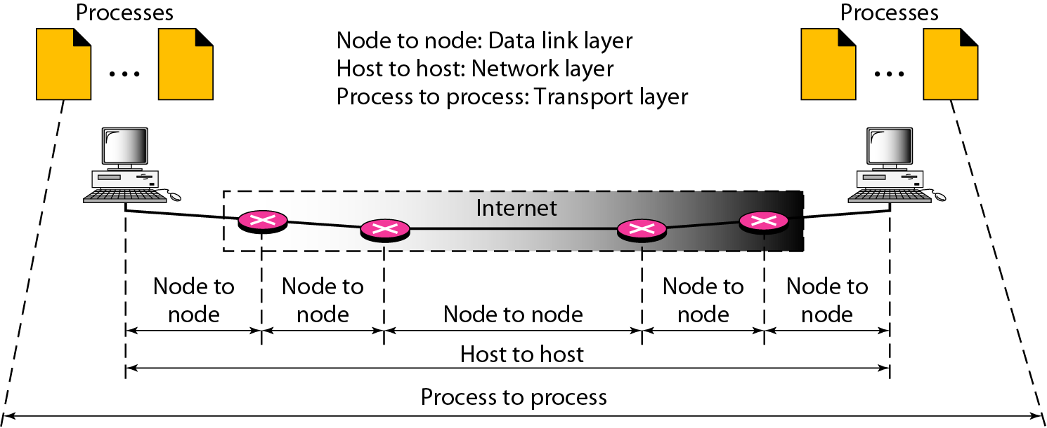
Types of data deliveries: Internet Stack

Slide 6
Continued..
The transport layer is responsible for process-to-process delivery—the delivery of a packet, part of a message, from one process to another.
It provides logical communication between app processes running on different hosts
transport protocols run in end systems
  send side: breaks app messages into segments, passes to network layer
  rcv side: reassembles segments into messages, passes to app layer
more than one transport protocol available to apps
  Internet: TCP and UDP

Slide 7
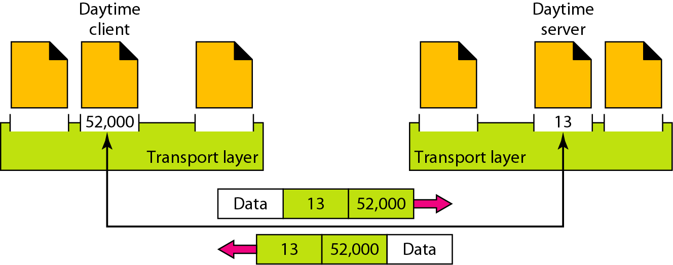
How It delivers messages to specific process
Using Port address (16 bit)
Ranges from 0 to 65,535

Slide 8
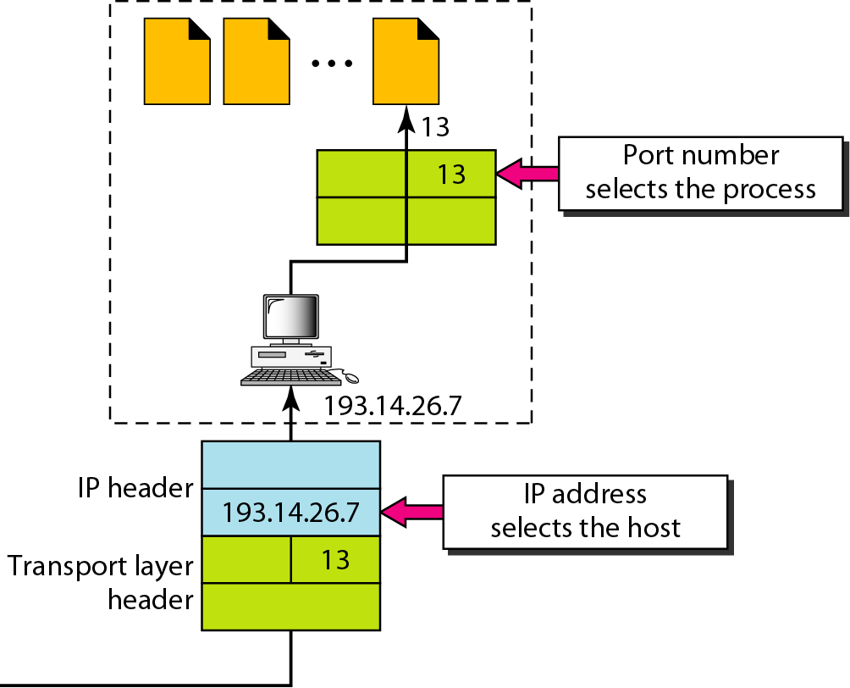
IP addresses versus port numbers

Slide 9
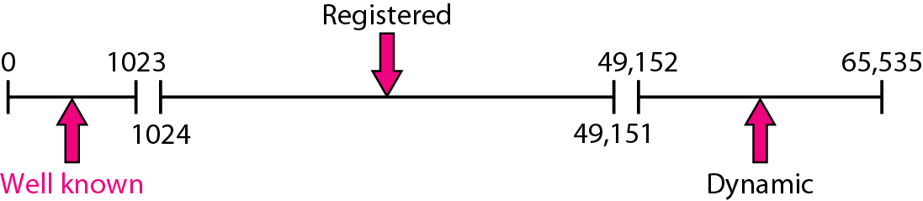
IANA ranges

Slide 10
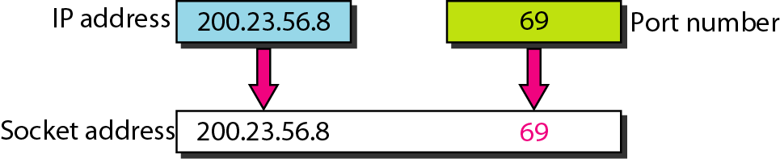
Socket address (IP address + Port Address)
What is the use of socket?
  The socket mechanism provides a means of inter-process communication (IPC).
  Socket is basically an API for enabling communication between two end points.
  A socket is one endpoint of a two way communication link between two programs running on the network.

Slide 11
Socket API
application
application
application
P4
P1
P2
P3
P1
P2
transport
transport
transport
network
network
network
link
link
link
physical
physical
physical
host 1
host 2
host 3
= socket
= process

Slide 12
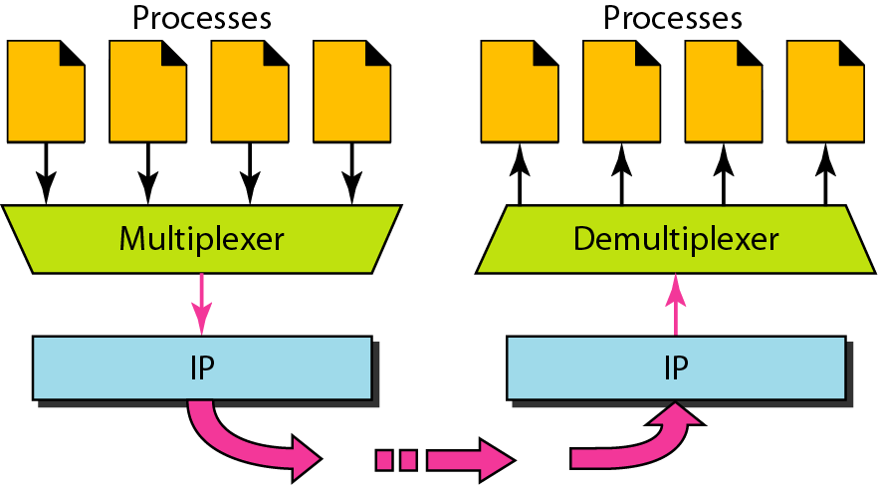
Multiplexing and demultiplexing

Slide 13
Multiplexing/demultiplexing
Demultiplexing at rcv host:
Multiplexing at send host:
delivering received segments
to correct socket
gathering data from multiple
sockets, enveloping data with
header (later used for
demultiplexing)
= socket
= process
application
application
application
P4
P3
P1
P2
P1
transport
transport
transport
network
network
network
link
link
link
physical
physical
physical
host 1
host 2
host 3

